Slide 1

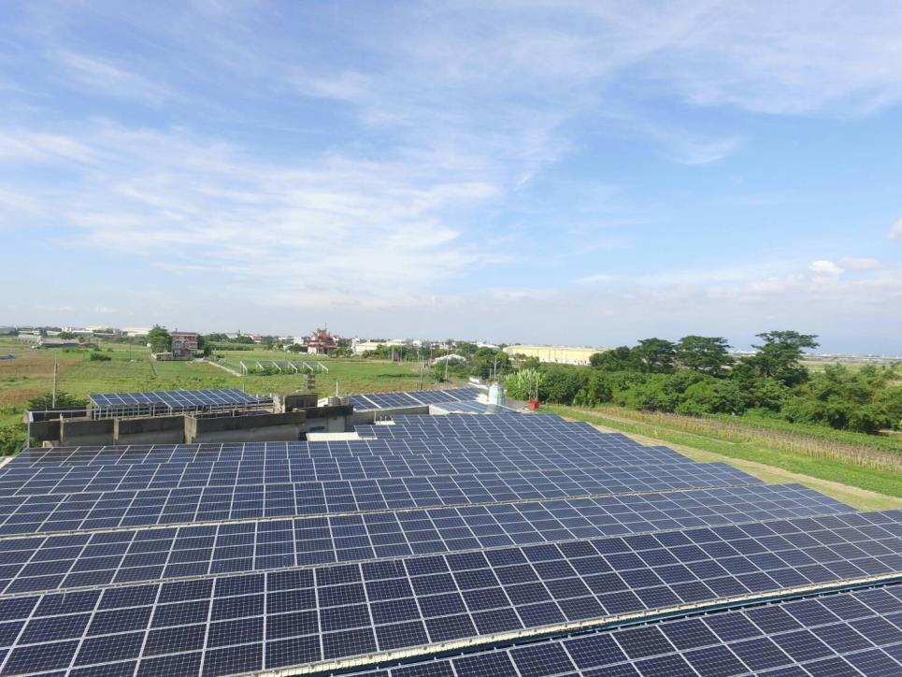
Using Electron to Package Angular
201901120 V1.3
Confidential

Slide 2
Summary of Contents
Introduce………………………… ……….P.3
Electron environment……………….P.5
Build electron……………………………P8
Electron-Builder environment ….P.10
Package file……………………………….P.13

Slide 3

introduce
Electron is an open source for building cross-platform desktop applications with HTML, CSS, and JavaScript. Electron accomplishes this by combining Chromium and Node.js into a single runtime and apps can be packaged for Mac, Windows, and Linux.

Slide 4
Install electron
Enter in your working directories
$npm install --save-dev electron@latest

Slide 5
Create main.js
Electron would know main.js
This file is used to link angular project to electron
https://ideone.com/lEmcAW <--paste it on main.js

Slide 6
Modify main.js
Line 5 : change to your custom window size
Line 8: remember to replace the “byoc-hmi” to correct directory name
Line 11:commit this line if you want to turn off developer tool

Slide 7


Modify package.json and index.html
"main": "main.js",
Add this line above “version” in package.json
In src/index.html
Replace <base href="/">
to
<base href="./">

Slide 8
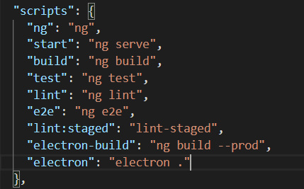
Build Electron
"electron-build": "ng build --prod", "electron": "electron ."
Append this in scripts in package.json

Slide 9
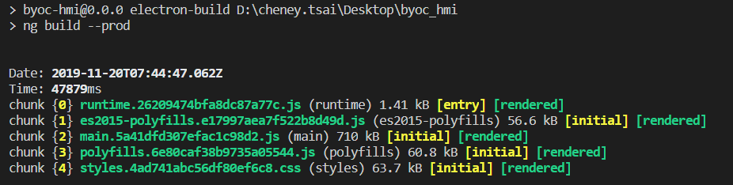
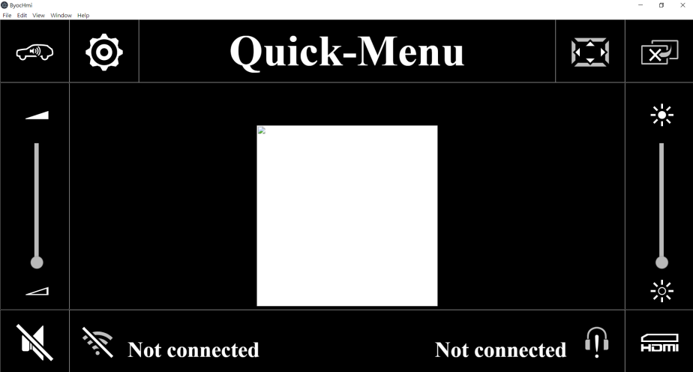
Run Electron
$npm run electron-build
$npm run electron
Congratulations!! You can run angular as desktop app

Slide 10
Install Electron-Builder
$yarn add electron-builder --dev

Slide 11
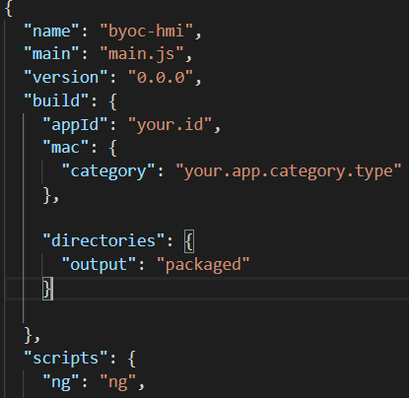
Append “build”
"build": {
"appId": "your.id",
"mac": {
"category": "your.app.category.type"
},
"directories": {
"output": "packaged"
}
},
Add “build” in package.json

Slide 12
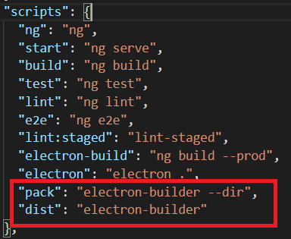
Modify script
"pack": "electron-builder --dir",
"dist": "electron-builder"
Append those 2 lines in package .json in script

Slide 13
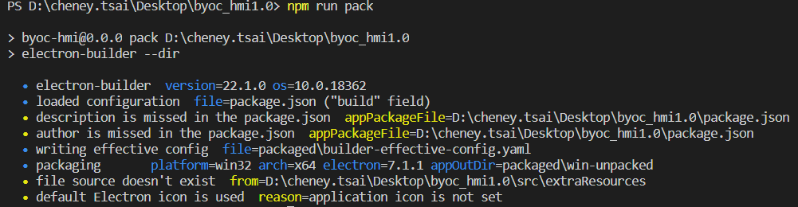
Packaging
$npm run pack
Package as a execute file and directory
Ouput is in ./packaged

Slide 14
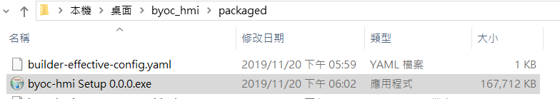
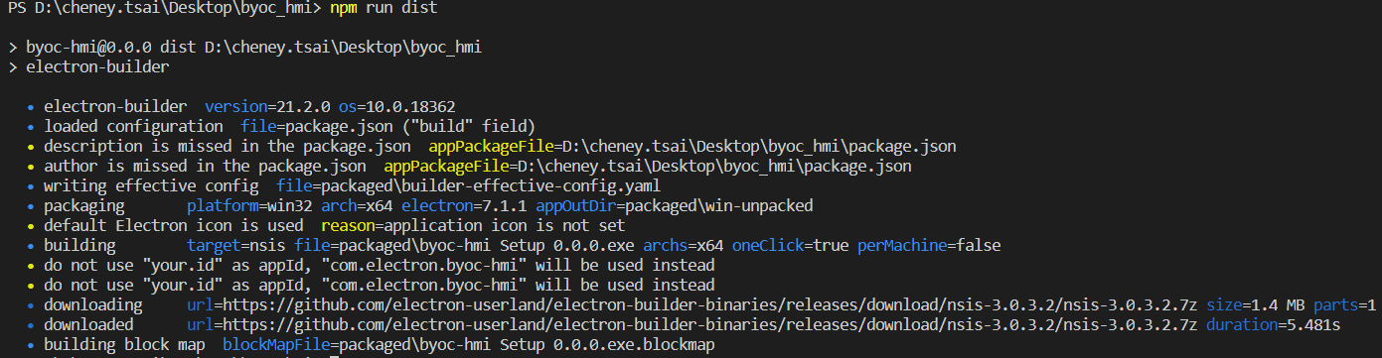
Setup exe
$npm run dist
Package as a setup fie
Ouput is in ./packaged

